Slide 1
Presentation 6 (Case 67, Match 1)
Olivia Joung

Slide 2
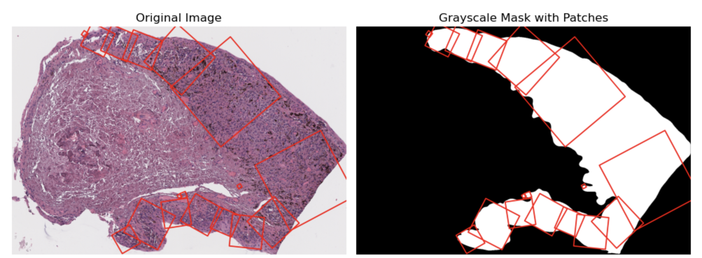
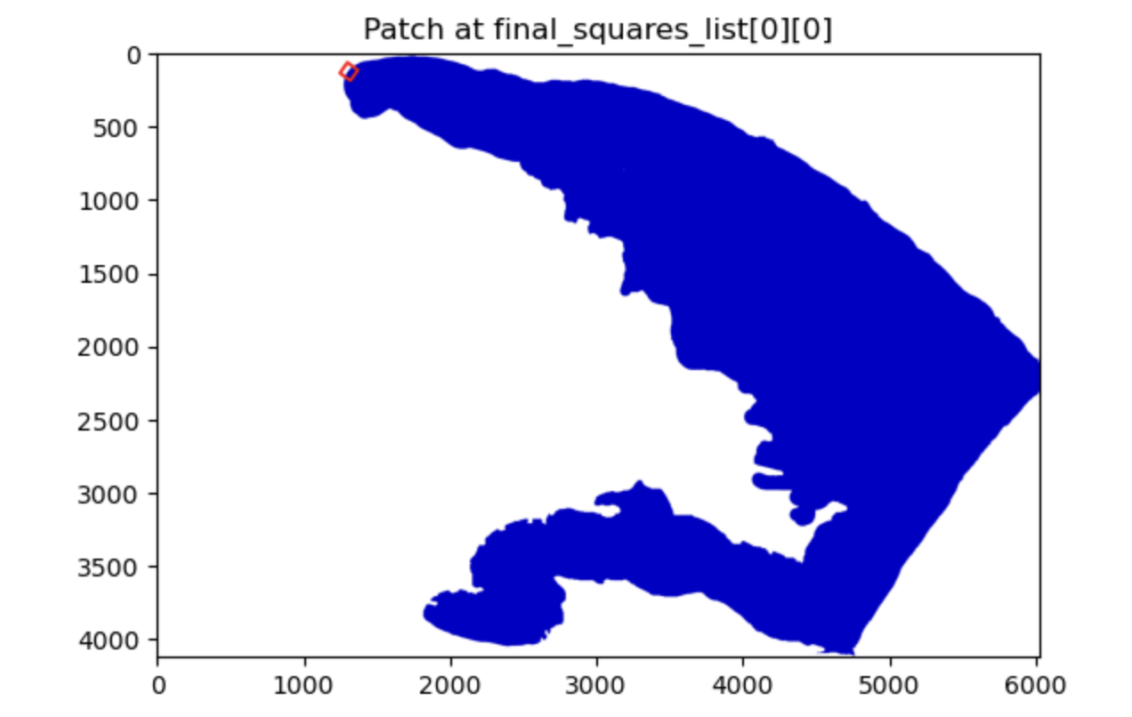

Slide 3
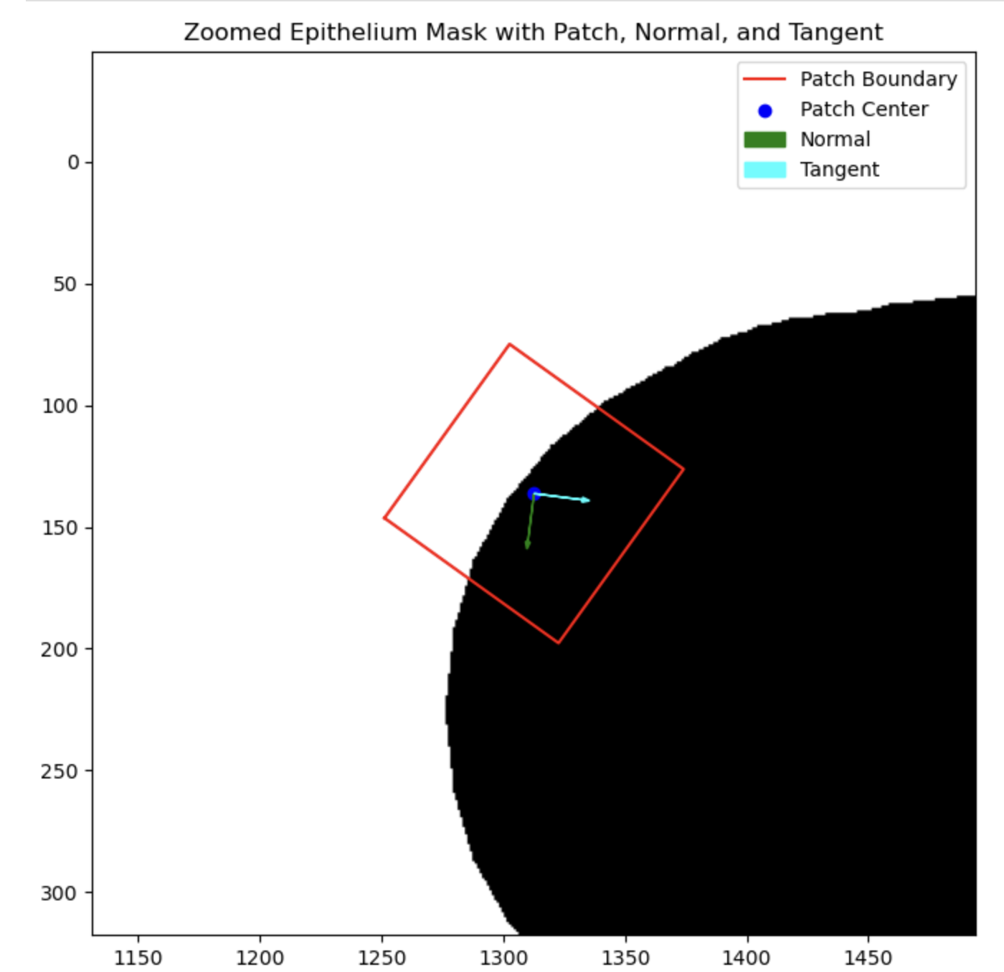
Issues:
Normal/tangent vector placements - Tangent not aligned with contour boundary direction, also causing incorrect normal vector
Patch rotation - Actual rotation of the patch also does not follow the projected path of the normal line (not parallel)
`calculate_patch_corners` - Patch should extend across entire epithelium width, given direction of normal vector
NOTE: After the rest of the presentations, this issue doesn’t seem as relevant—primary issue is likely the normal/tangent line placements.
Notes:
The error here appears to be that the patch fails despite the fact that the normal vector here would appear to capture the epithelium width if extended.
Therefore, the issue in my case appears to be with the function calculate_patch_corners (since the patch should extend across the entire width), in addition to the functions calculating the normal vector (since one would think, from looking at this image, that this particular normal vector appears (Appears to not leverage the normal direction to the best of its abilities)

Slide 4
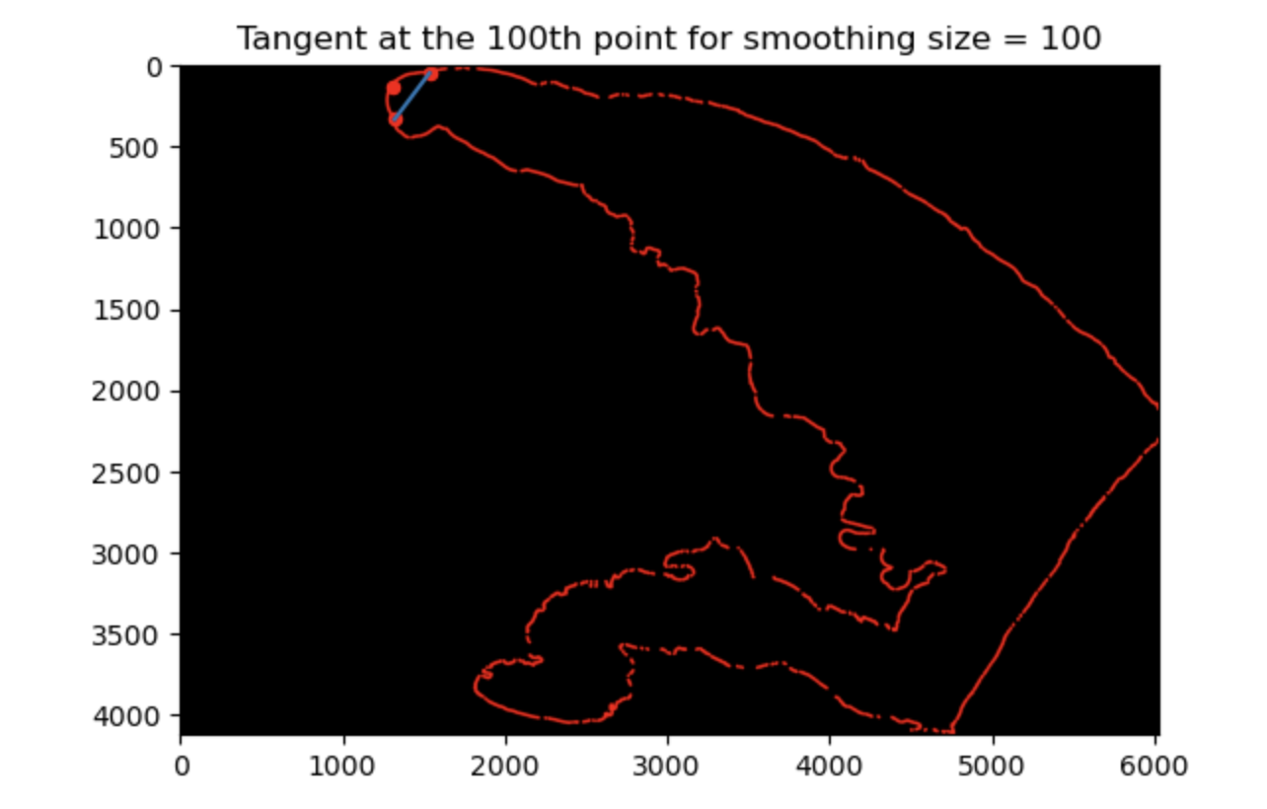
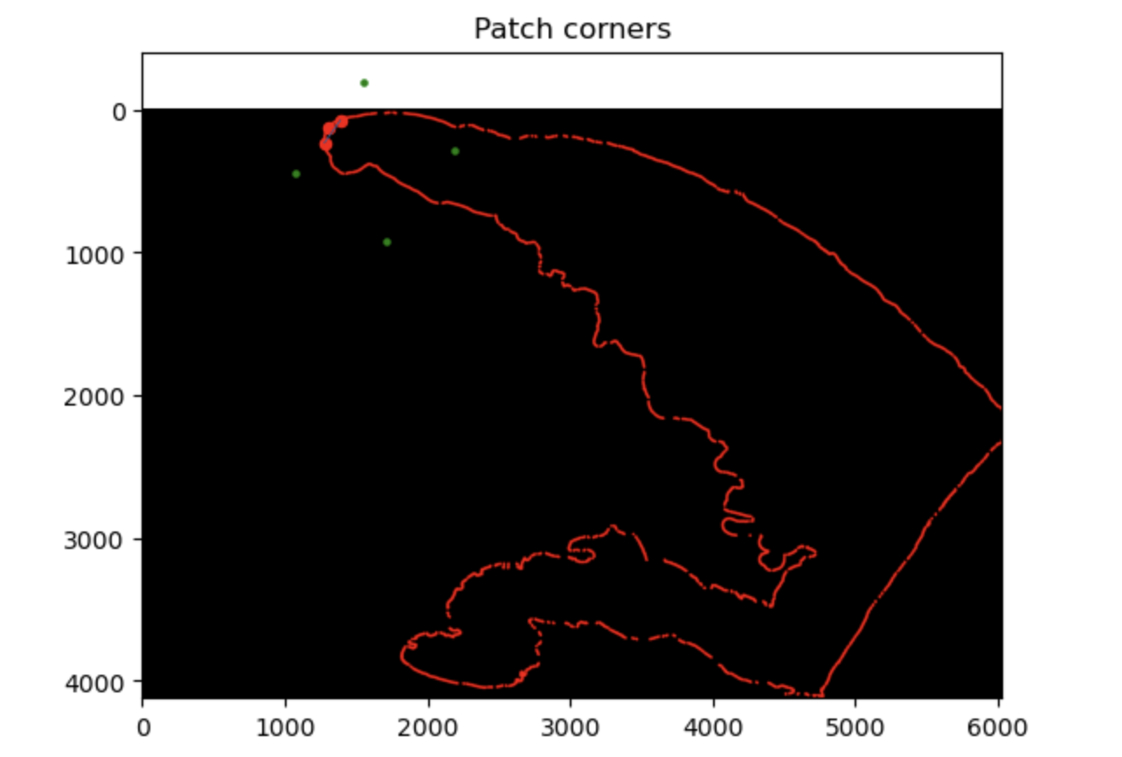
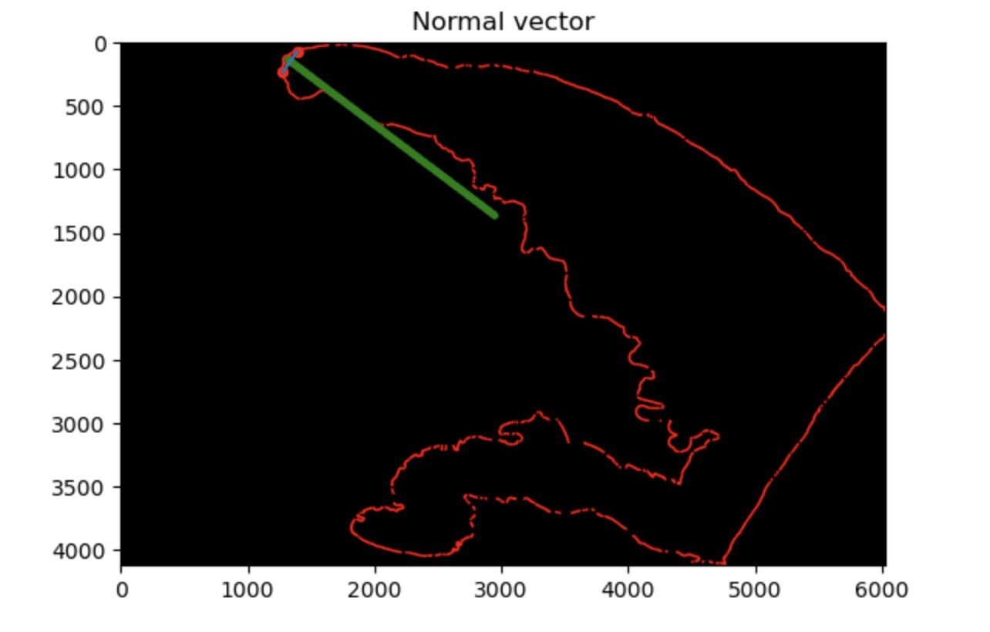
Additional findings: Running the debugger code on the same patch, the tangent and normal vectors (as well as the patch placement/size) did in fact appear to be correct.

